Slide 1
Image to Chord Spectrogram Generation
ENGS 106: Principles of Machine Learning
Professor Peter Chin
Harry Leiter - Taka Khoo - Doruk Ozel

Slide 2
Objectives & Components
Linking Digit Images to Musical Chords
Key Components
Data Conditioning Pipeline (upscaling, Gaussian Weighting, Frequency Isolation, Noise)
U-Net Architecture + Skip Connections for image-to-spectrogram mapping (specialized encoder-decoder)
Mixed Losses (Huber, MS-SSIM, etc.)
Audio Generation from final spectrogram
We aimed to convert a 28x28 digit image into a 1008x1008 spectrogram that encodes a major triad chord
The major triad chord consists of the tonic (fundamental frequency), the major third, and the perfect fifth, as well as all of its harmonics
Visually embody digits in the audio realm, combining image processing, deep learning, and music theory

Slide 3
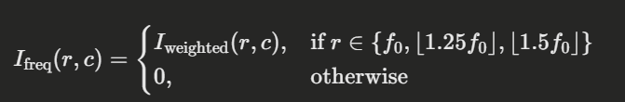

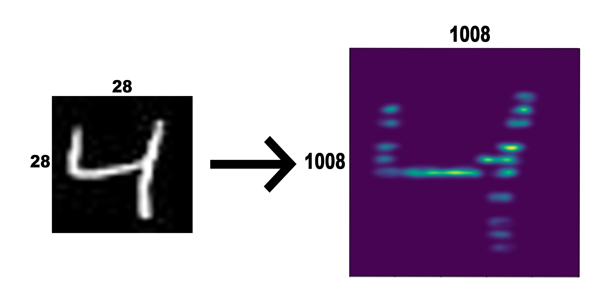
The Data Conditioning Pipeline
Frequency Selection
Stage I
Gaussian Weighting
Upscale digit from 28x28 to 1008x1008
Gaussian Weighting (vertical fase)
Simulates Natural Decay
Frequency selection for f0 (fundamental), 1.25f0, and 1.5f0 ;zeroing out remaining rows
Manufactures chord lines at specific frequency rows
Integer rounded to ensure maintenance of all lines
Gaussian Smearing + 2D smoothing in order to soften edges
Perlin noise addition: realistic texture and more robust sound
Network Prevention of overly smooth / “overfitted” solution
Normalization to [0,1]

Slide 4
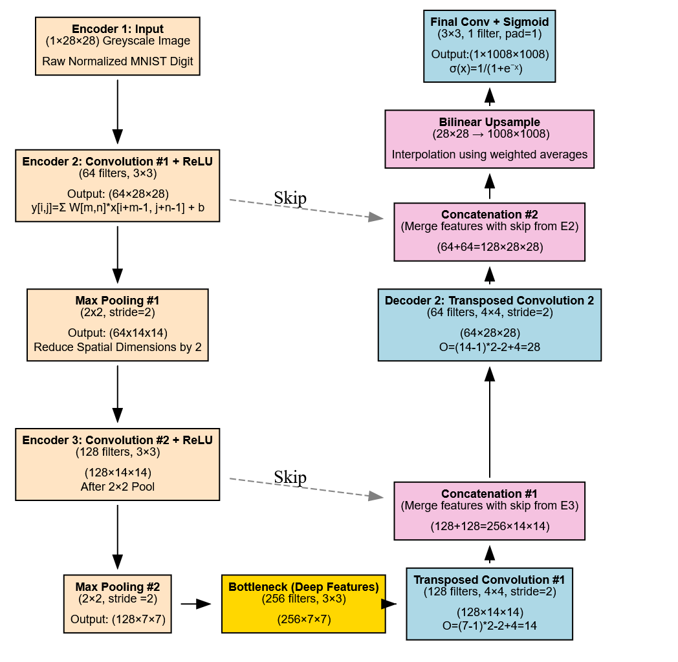

The U-Net
Stage II
Encoder: 2 Blocks to Downscale
Bottleneck: Preserve Features
Decoder
Upsample + Concatenate
Final Output
Compresses Spatial Information in encoder, recover using skip connections
Concatenations allow decoder to access fine-grained details lost during pooling

Slide 5
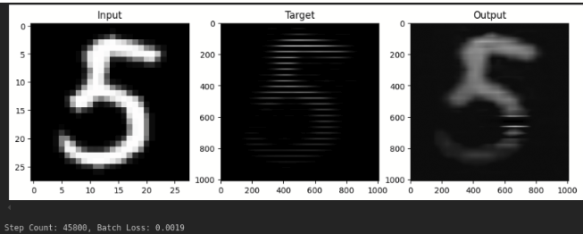
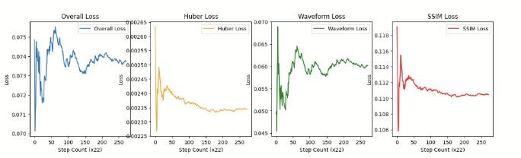
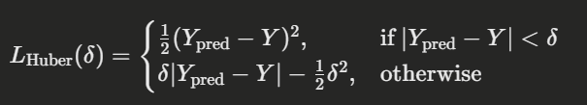


Training Strategy & Loss Functions
Stage III
Loss Components
Huber Loss
MS-SSIM Loss
Frequency Domain STFT Loss
Combined Loss w/ weights
Training Techniques
Adam Optimizer is employed
Mixed-precision training with AMP (Automatic Mixed Precision)
Curriculum learning (focusing on difficult digits)
Dynamic Adjustment of Learning rate (“bumps”) to escape Local Minima
Trying to balance pixel-wise loss w/ structural similarity index loss

Slide 6

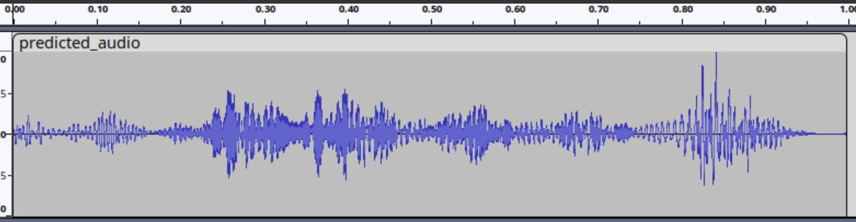
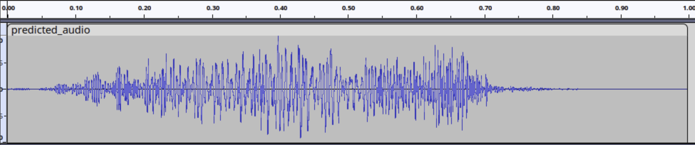
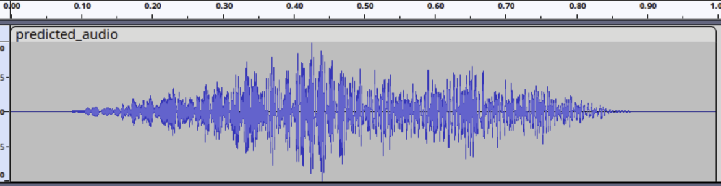
Inference & Audio Generation
Final Audio Waveform
Stage IV
f determined from harmonic mapping, ϕ is a randomized phase
Input: 28x28 digit image
Output: 1008x1008 Spectrogram normalized to [0,1]
Audio Synthesis
Each row corresponds to a frequency
Summed sine waves yield a stable major triad chord
Conversion from spectrogram to audio uses row amplitudes to modulate the sine waves
Only chord frequencies are bright
Output audio files consistently produce real chordal frequencies

Slide 7

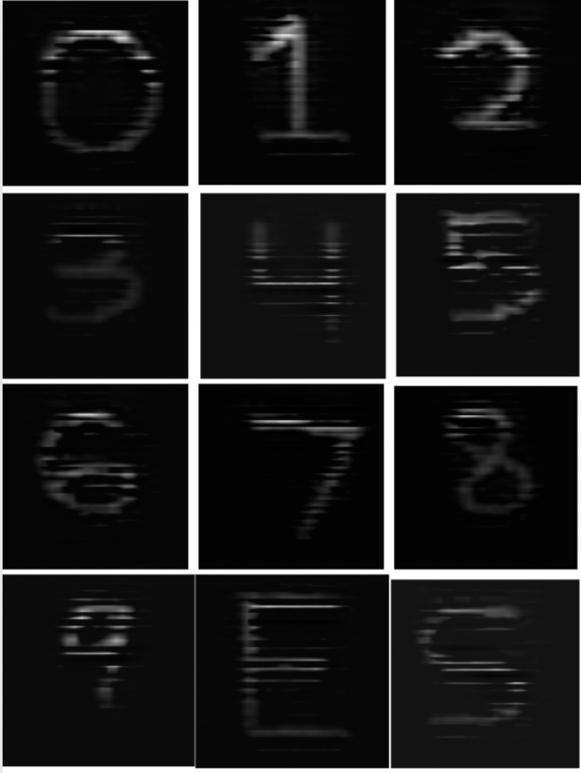
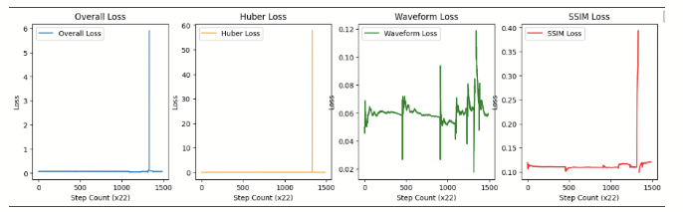
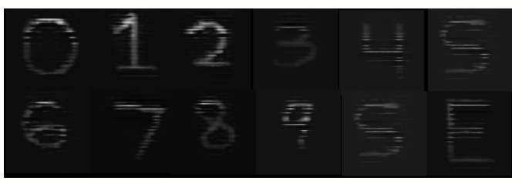
Experimental Results, Issues and Discussion
Visual Results
Outputs produced consistent frequency bands, but the locations were not always accurate
Struggled with blurring, particularly for the number 3 and, prior to curriculum learning, 5
Certain digits like 0 produced consistently correct band locations
Audio Quality
Qualities of the desired note are present in the output audio file, but noise is introduced
Attempt at training U-Net without skip connections resulted in better audio quality, but image similarity was lost
Exploding/Vanishing Gradients
Introducing phase loss resulted in vanishing/exploding gradients where the image would become all white or all black, stuck in a suboptimal solution
STFFT resulted in suboptimal training, producing random banding with minimal likeness to the input image and incorrect frequency values
Training Optimization
Mixed precision was used to improve efficiency
Higher LR like 1e-3 did not converge to the desired frequency bands, 1e-4 proved the most effective
MSE produced fuzzy outputs, Huber loss with delta=.5 was implemented to increase contrast

Slide 8
Conclusion
Future Work
Extend to minor/dominant chords & more complex harmonic structures
Implement adaptive learning rate schedules & advanced frequency alignment
Real-Time Interface: “Draw anything, hear a chord” applications
Achievements
Developed a pipeline converting digit images to chord spectrograms
Implemented a U-Net with skip connections to preserve fine frequency
Combined multiple loss functions to balance pixel accuracy & structural similarity
Challenges
Overcoming local minima, ensuring consistent harmonic output
Exploding gradients
CPU & GPU usage in loading target data
Trade-offs between different losses
Learning Rate Experimentation

